Slide 1
Updated tuberculosis guidelines
Makwakwa SG – Pharmacist
25 September 2025

Slide 2
Pathophysiology of TB in children
Pulmonary TB (PTB) is the most common form of TB in children.
Children typically have paucibacillary disease (have fewer bacilli), making it more difficult to confirm the diagnosis bacteriologically.
Extra-pulmonary TB (EPTB) is also common and may coexist with PTB; presentation of EPTB varies with age.
Children usually develop TB within 12 months following exposure to a source patient.
Being of a younger age, living with HIV or HIV exposure, and/or having severe malnutrition are all risk factors for developing TB disease after TB exposure/infection.
TB disease can be more severe and of rapid onset in infants and young children (<5 years of age).
The BCG vaccine is not fully protective against TB disease but is protective against severe forms of TB in infants and young children and is, therefore, very important to give to all children at birth.
The presentation of and approach to diagnosing PTB in adolescents is similar to that for adults.
Bacteriological confirmation is more likely in adolescents, who often have adult-type (cavitary) PTB disease

Slide 3
Pathopysilogy of TB in children
Children usually develop TB after inhaling droplet nuclei containing Mycobacterium tuberculosis (M. tb), which have been coughed or breathed out by another person with infectious TB disease. This person is usually an adult or older child and can be called “the source patient”. Droplet nuclei can remain in the air for several hours. When a child inhales these infected droplets, the M. tb, or TB bacilli, may breach the innate immune system to reach the terminal alveoli, where they multiply to form a parenchymal focus in the lung.
This is called the primary focus or Ghon focus. The bacilli are then carried via the lymphatic system to the nearest mediastinal lymph node, which, together with the Ghon focus, form the Ghon complex (See Figure 1 below). The child may be asymptomatic or minimally symptomatic, and the infection is usually contained by the immune system (with low numbers of TB bacilli persisting) or completely cleared. Children with no symptoms and no radiological changes on CXR are classified as having TB infection (previously termed ‘latent’ TB) and do not have TB disease. These children should be considered for TB preventive treatment (TPT). However, if the bacilli overcome the constraints of the immune system and multiply, there is progression to symptomatic TB disease, which is accompanied by radiological changes on CXR (which may involve other sites of disease). EPTB usually develops after spreading via the lymphatic system or haematogenous spread in organs/systems other than the lungs and may be present without PTB changes in the CXR.

Slide 4
Pathophysiology
Tuberculosis infection: Clinical picture?
01
02
Clinical picture
Investigations
Different pathophysiology means different clinical picture
Symptoms vaugue , hard to diagnose
Paucibacillary TB
Hard to collect specimen
Gastric aspirates
TB should be considered part of the differential diagnosis in ANY ill child, especially if no alternative cause for symptoms is found or if there is a history of TB exposure.
3
Outcomes
Good outcomes if started early , bad outcomes if not.

Slide 5
Tuberculosis – Patient history
History of TB exposure
A history of significant exposure to a TB source patient is defined as:
Exposure, within 12 months
to a person (adult or adolescent) with pulmonary TB within the same enclosed space for ≥ 1 night (e.g. at home or similar) or for frequent or extended daytime periods (e.g. at a school, crèche or similar)
during the three months before the source/index patient started TB treatment.”

Slide 6
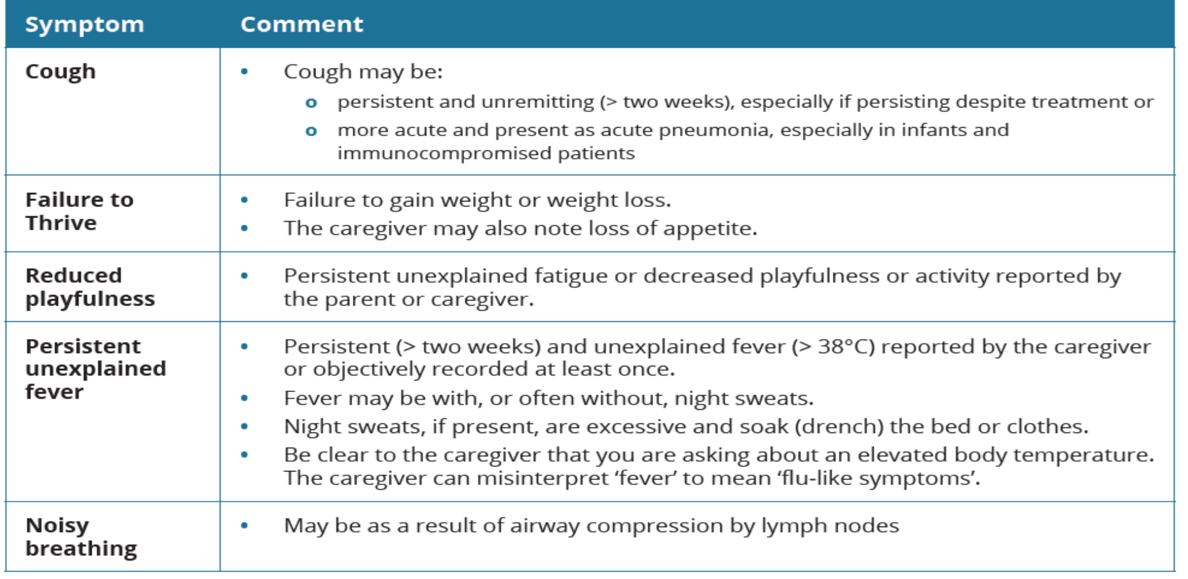
Symptoms PTB

Slide 7
Treatment for tuberculosis
The TB treatment regimen should be continued until completion unless an alternative diagnosis has been confirmed.
Therapeutic trials of TB treatment are not recommended.
Each TB treatment episode should be entered into the TB treatment register and reported to the TB programme.
The treatment principles of DS-TB in children are similar to those used in adults. Treatment consists of 2 phases:
An intensive phase of 2 months consisting of 4 drugs:
isoniazid, rifampicin and pyrazinamide, and ethambutol
A continuation phase consisting of 2 drugs:
Isoniazid and rifampicin

Slide 8
Treatment cont
All children and adolescents with DS-TB (excluding TBM, other forms of CNS TB and miliary TB) will initiate the same intensive phase of TB treatment using four anti-TB medications.
The duration of the continuation phase depends on:
  the eligibility for treatment shortening,
  the site of TB and
  the response to therapy:
TB drugs are dosed in weight bands and should be adjusted as the child grows.
0

Slide 9
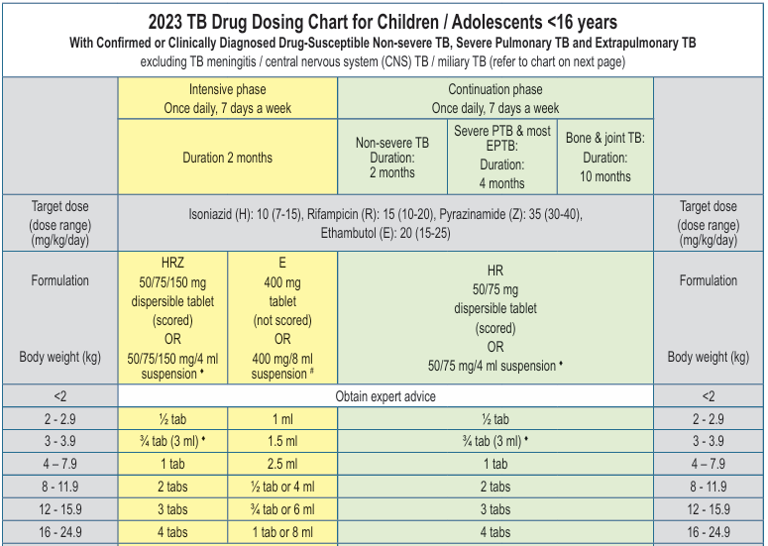
Treatment cont

Slide 10
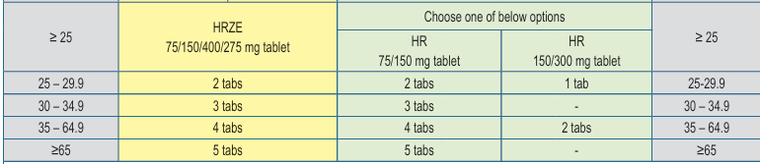
Treatment cont

Slide 11
Treatment cont
Children should be taught and encouraged to swallow whole tablets
HRZ50/75/150mg & HR 50/75mg: To make an oral suspension, for weight band 3 – 3.9 kg, for each dose:
disperse 1 x HRZ 50/75/150 mg tablet (2 months intensive phase) or
1 x HR 50/75 mg tablet (continuation phase) in 4 ml of water, administer 3 ml, discard unused suspension.
For other weight bands, an oral suspension can be made by dispersing the required number of tablets & fractions of tablets in a small amount of water (5-10 ml) and administering all of the suspension to the child orally or via nasogastric tube.
If oral suspension required, for each dose, crush 1 x Ethambutol 400 mg tablet to a fine powder, disperse in 8 ml of water to prepare a concentration of 400 mg/8 ml (50 mg/ml), administer required dose as indicated in above chart, discard unused suspension.

Slide 12
Treatment cont
Isoniazid may cause symptomatic pyridoxine deficiency in certain at-risk patients, leading to peripheral neuropathy.
Pyridoxine is therefore recommended in the following populations:
Malnourished children
CALHIV
Breastfed infants
Children or adolescents older than eight years
Children receiving high-dose INH (as with TBM/miliary TB)
The recommended oral dosage for supplemental pyridoxine is:
• < 5 years: 12.5 mg/day (½ tablet)
• ≥ 5 years: 25 mg (1 tablet)

Slide 13
TPT
Different types of TB Prevention methods:
BCG
TB preventative therapy (TPT)
Infection Prevention& Control in Health Care Facilities
Administrative control measures
Environmental control measures
Personal protection control measures
Contact Investigation
Outbreak response

Slide 14
TPT
TB EXPOSURE
TB INFECTION
TB DISEASE
TPT

Slide 15


TPT

Slide 16
Who is eligible for TPT?
All People living with HIV
Who have not completed a course of TPT before
Who are contacts of people with active TB
All contacts of people with active TB disease
in whom active TB disease has been excluded
All People living with Silicosis
In whom active TB disease has been excluded

Slide 17
TPT – NOT LEGIBLE
People with unconfirmed active TB
  Exclude TB before starting TPT
  If TB develops on TPT, stop TPT and start patient on treatment
Patients with active liver disease (acute or chronic)
Patients with symptoms of severe peripheral neuropathy
Patients with a history of adverse reaction to drugs used for TPT
People who have completed treatment of MDR- or XDR-TB
Patients who are ill and/or are in unstable condition

Slide 18
TPT – AVAILABLE REGIMENS
3HP ( 3 months Rifapentine& INH)
3RH( 3 months Rifampicin&INH)
6H (6 months INH)
12H (12 months INH)

Slide 19
3HP
Adults and adolescents living with HIV with no TB disease or symptoms and signs of TB; VL suppressed if on DTG-based regimen.
HIV negative patients > 25kg

Slide 20
3HP CONTRAINDICATIONS
Weight <25kg
Pregnant or breastfeeding mothers
Females unwilling / unable to use non hormonal contraception
Confirmed TB disease
Newly diagnosed PLHIV starting on TLD
Presence of symptoms and signs of TB
On Protease Inhibitor – based ART
History of adverse reaction to any of the drugs used for TPT;
Adults and adolescents living with HIV who have completed TPT and have no recent TB exposure

Slide 21
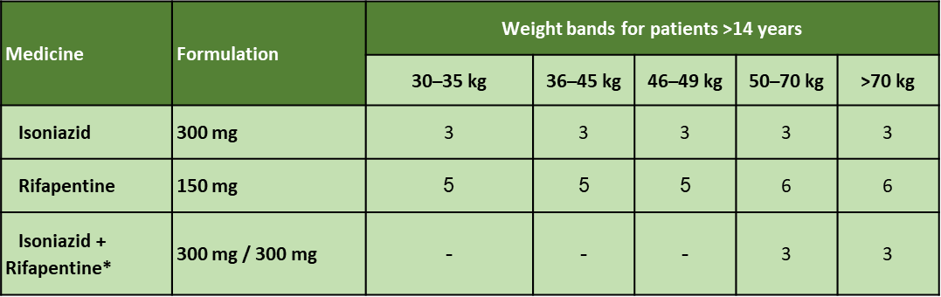
TREATMENT DOSAGES FOR 3HP
Add Pyridoxine 25mg weekly in PLHIV (increase to 50mg if symptoms of peripheral neuropathy)

Slide 22
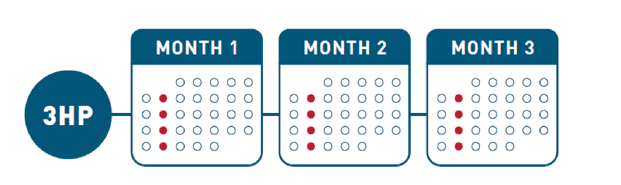
HOW TO ADMINISTER 3HP
  12 weekly doses
  The appropriate dose must be taken at once on the same day every week for 12 weeks
  A course is considered completed if all doses are taken within 16 weeks (11 doses can be counted as complete although not ideal)

Slide 23
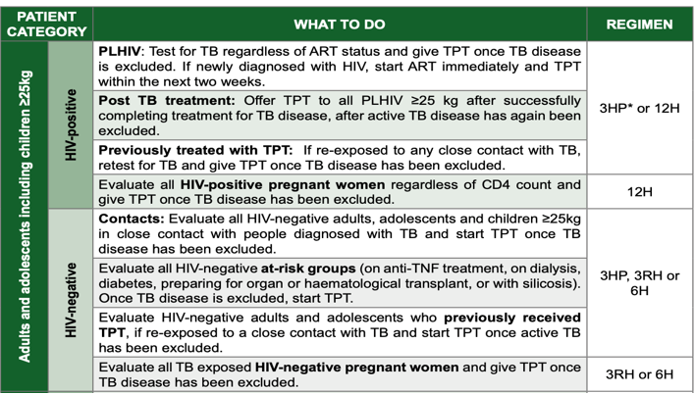

Slide 24
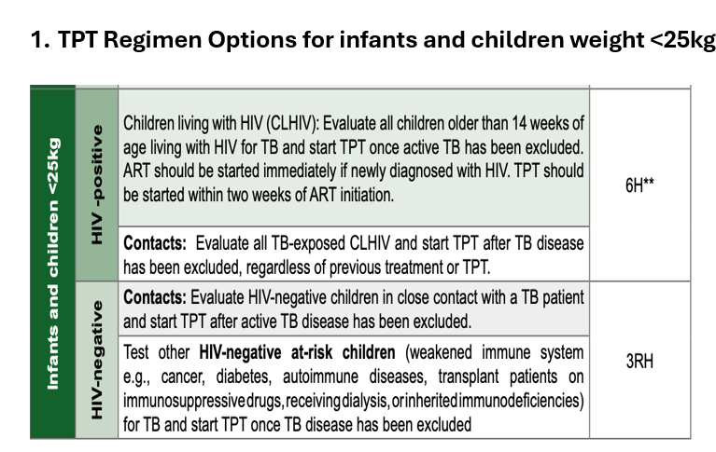

Slide 25
STOPPING TPT
When active TB is suspected, investigate for TB,
Stop TPT and investigate for TB
If TB Positive start TB Treatment
Hepato-toxicity possible due TPT-discontinue TPT immediately and refer to hospital
Hypersensitivity rash:
if mild stop INH until rash is resolved and refer to the doctor for re-challenge ,
if severe , stop and refer urgently

Slide 26
CONCLUSION
Treatment of latent TB infection is an important strategy to prevent TB disease.
Screen for active TB prior to initiation of TB treatment.
Monitor TPT adherence and side effects while on treatment.

Slide 27


