Slide 1

1
Latent TB infection & TB Preventative therapy in Children and adolescents

Slide 2
Outline
TB prevention strategies.
Latent TB infection
TPT eligibility criteria
3HP TB preventative therapy
Alternative TPT regimens

Slide 3
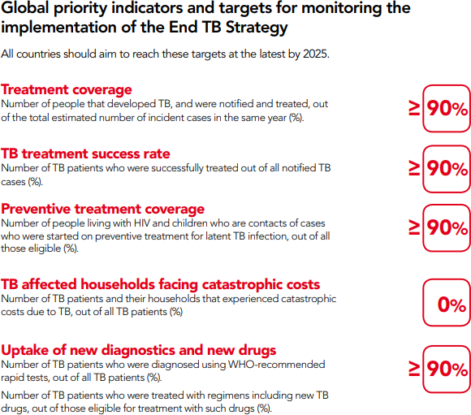
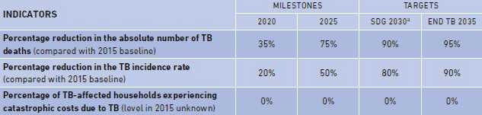
End TB Strategy
Vision, Goal, Indicators, Milestones & Targets
Endorsed by : All WHO & UN members in 2014 & 2015.
VISION : World Free of TB ( = Zero death, disease, suffering due to TB).
GOAL : End The Global TB Epidemic by 2035 and eliminate TB by 2050.

Slide 4

Measures to prevent TB infection

Slide 5
TB prevention methods
Different types of TB Prevention methods:
BCG
TB preventative therapy (TPT)
Infection Prevention& Control in Health Care Facilities
  Administrative control measures
  Environmental control measures
  Personal protection control measures
Contact Investigation
Outbreak response

Slide 6
TB PREVENTIVE THERAPY (TPT)

Slide 7
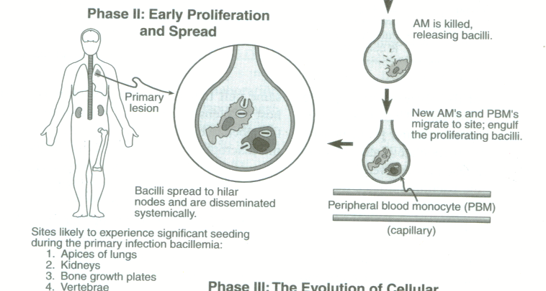
Pathogenesis of TB
Notes:
Infection depends on the virulence of the bacilli and the microbicidal activity of the macrophages

Slide 8
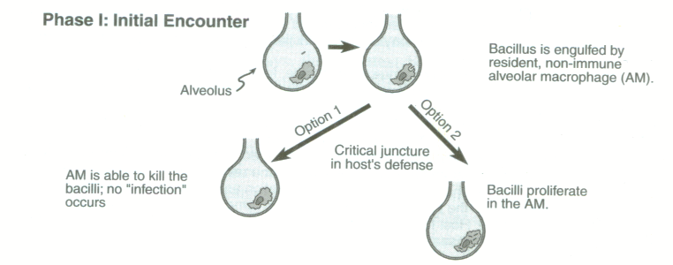
Pathogenesis of TB
Notes:
If the bacilli are able to proliferate ,Within 2-12 weeks post exposure there is sufficient organisms to illicit a cellular response therefore exposure can be detected by TST.

Slide 9
Where does IPT work?
TB EXPOSURE
TB INFECTION
TB DISEASE
Multiple studies have shown that TPT reduces TB incidence in HIV-infected patients
TB incidence among HIV- infected patients receiving ART is greater than the general population.
TPT

Slide 10

Screen for TB before initiating TPT

Slide 11
Who is eligible for TPT?
All People living with HIV
Who have not completed a course of TPT before
Who are contacts of people with active TB
All contacts of people with active TB disease
in whom active TB disease has been excluded
All People living with Silicosis
In whom active TB disease has been excluded

Slide 12
Who is not eligible for TPT
People with unconfirmed active TB
  Exclude TB before starting TPT
  If TB develops on TPT, stop TPT and start patient on treatment
Patients with active liver disease (acute or chronic)
Patients with symptoms of severe peripheral neuropathy
Patients with a history of adverse reaction to drugs used for TPT
People who have completed treatment of MDR- or XDR-TB
Patients who are ill and/or are in unstable condition
Notes:
Could conside 4R in patients with severe peripheral neuropathy who are high risk.

Slide 13
Available regimens
3HP ( 3 months Rifapentine& INH)
3RH( 3 months Rifampicin&INH)
6H (6 months INH)
12H (12 months INH)
Notes:
Regimens dosed according to weight.

Slide 14
Who is eligible for 3HP?
3HP Eligibility in South Africa
Adults and adolescents living with HIV with no TB disease or symptoms and signs of TB; VL suppressed if on DTG-based regimen.
HIV negative patients > 25kg
Notes:
Limited data on the safety and efficacy of Rifapentine in children less than 2.

Slide 15
Contra-indications to 3HP
Contraindications to 3HP(1)
Weight <25kg
Pregnant or breastfeeding mothers
Females unwilling / unable to use non hormonal contraception
Confirmed TB disease
Newly diagnosed PLHIV starting on TLD
Presence of symptoms and signs of TB
On Protease Inhibitor – based ART
History of adverse reaction to any of the drugs used for TPT;
Adults and adolescents living with HIV who have completed TPT and have no recent TB exposure
Notes:
3HP interim clinical guidance

Slide 16
Treatment Dosages for 3HP
Dosage in adolescents
Medicine | Formulation | Weight bands for patients >14 years
 |  | 30–35 kg | 36–45 kg | 46–49 kg | 50–70 kg | >70 kg
Isoniazid | 300 mg | 3 | 3 | 3 | 3 | 3
Rifapentine | 150 mg | 5 | 5 | 5 | 6 | 6
Isoniazid + Rifapentine* | 300 mg / 300 mg | - | - | - | 3 | 3
Add Pyridoxine 25mg weekly in PLHIV (increase to 50mg if symptoms of peripheral neuropathy)
Notes:
16

Slide 17
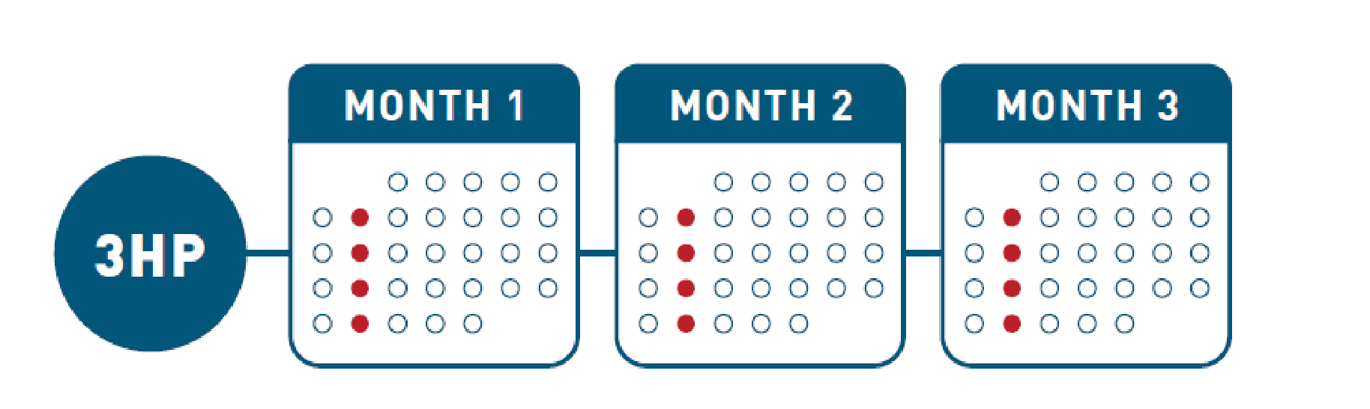
How to Administer 3HP ?
  12 weekly doses
  The appropriate dose must be taken at once on the same day every week for 12 weeks
  A course is considered completed if all doses are taken within 16 weeks (11 doses can be counted as complete although not ideal)
Notes:
The weekly dose must be taken
All at once (not divided)
On the same day every week
Not closer than 4 day’s apart (if the day is missed) – WHP trial
In the case of missed doses, it is acceptable for the 12 week course to be taken over 16 weeks
Pyridoxine (25 or 50mg) has routinely been administered with INH in PLHIV but there are no controlled trials where pyridoxine has not been given to objectively assess its efficacy. In the absence of compelling evidence, the WHO does not mandate pyridoxine for routine use. The I4TB project will be aligned to country guidance which is commonly to give pyridoxine to adults and children living with HIV.
(Pyridoxine is not required for otherwise healthy contacts of TB index patients of any age)
17

Slide 18
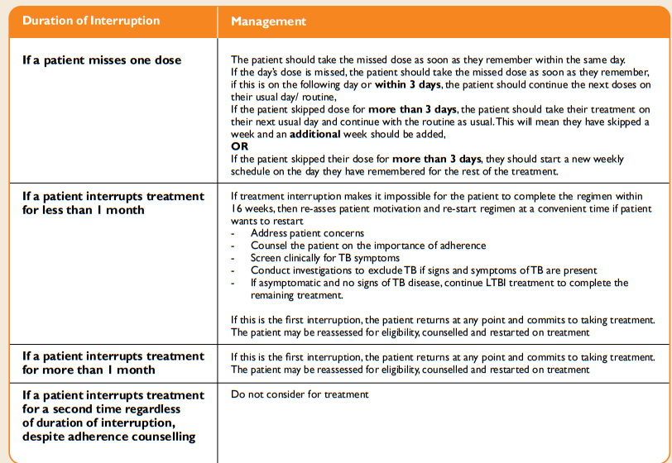
Treatment interruption

Slide 19
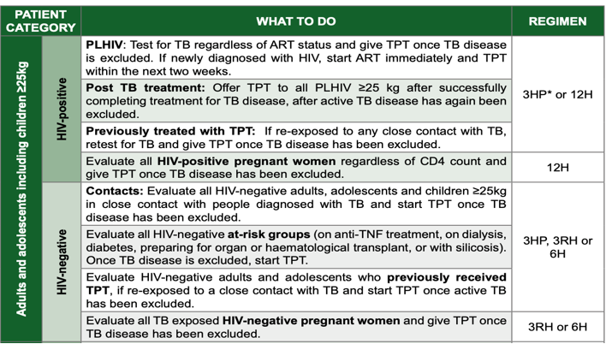
TPT regimen options >25kg

Slide 20
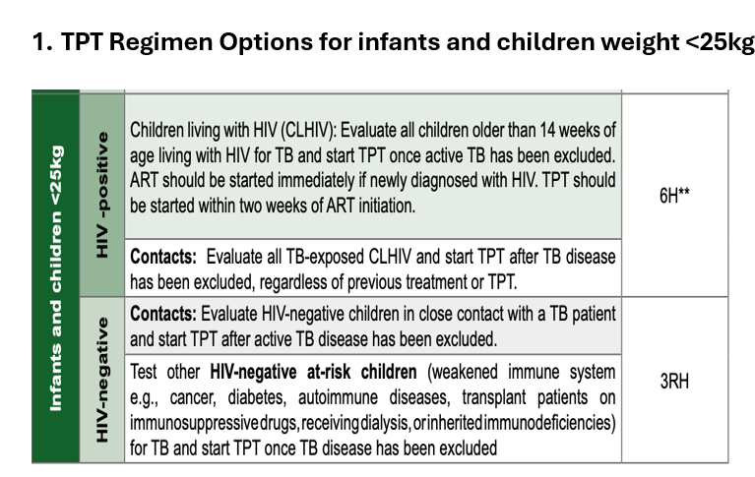
TPT regimen options

Slide 21
Stopping TPT
When active TB is suspected, investigate for TB,
  Stop TPT and investigate for TB
  If TB Positive start TB Treatment
Hepato-toxicity possible due TPT-discontinue TPT immediately and refer to hospital
Hypersensitivity rash:
  if mild stop INH until rash is resolved and refer to the doctor for re-challenge ,
  if severe , stop and refer urgently

Slide 22
Conclusion
Treatment of latent TB infection is an important strategy to prevent TB disease.
Screen for active TB prior to initiation of TB treatment.
Monitor TPT adherence and side effects while on treatment.

Slide 23


